Slide 1
Artificial Intelligence Introduction to Logic
unknown
RL
known
deterministic
stochastic
atomic
SEARCH
MDPs
factored
LOGIC
Bayes nets
structured
First-order logic

Slide 2
Outline
Introduction to logic
Basic concepts of knowledge, logic, reasoning
Propositional logic: syntax and semantics
Propositional logic: inference
Agents using propositional logic
First-order logic

Slide 3
Knowledge Representation
Intended role of knowledge representation in AI is to reduce problems of intelligent action to search problems. -- Ginsberg, 1993
An Analogy between AI Problems and Programming
Programming
Artificial Intelligence
Devise an algorithm to solve the problem
Select a programming language in which the algorithm can be encoded
Capture the algorithm in a program
Run the program
Identify the knowledge needed to solve the problem
Select a language in which the knowledge can be represented
Write down the knowledge in the language
Use the consequences of the knowledge to solve the problem
It is the final step that usually involves search

Slide 4
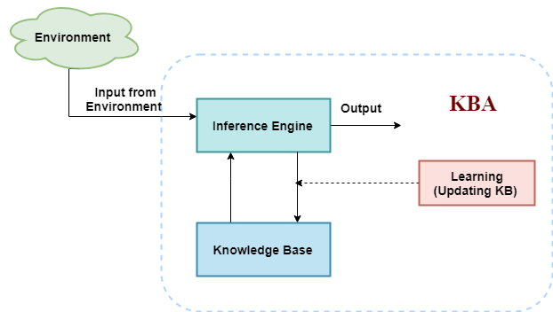
Knowledge Base Agent in AI
Knowledge-base:
It is a collection of sentences, expressed in a language which is called a knowledge representation language.
The Knowledge-base of KBA stores fact about the world.
Inference Engine:
Deriving new sentences from old.
Allows us to add a new sentence to the knowledge base.
Inference system applies logical rules to the KB to deduce new information.
Inference system generates new facts so that an agent can update the KB.

Slide 5
Knowledge-Based Agent Architecture
loop forever
Input percepts
state ← Update-State(state, percept)
rule ← Rule-Match(state, rules)
action ← Rule-Action[rule]
Output action
state ← Update-State(state, action)
end
Recall the simple reflex agent
A knowledge-based agent represents the state of the world using a set of sentences called a knowledge base.
This agent keeps track of the state of the external world using its "update" function.
loop forever
Input percepts
KB ← tell(KB, make-sentence(percept))
action ← ask(KB, action-query)
Output action
KB ← tell(KB, make-sentence(action))
end
At each time instant, whatever the agent currently perceived is stated as a sentence, e.g. "I am hungry".

Slide 6
Knowledge Base
Knowledge base = set of sentences in a formal language
Declarative approach to building an agent (or other system):
Tell it what it needs to know (or have it Learn the knowledge)
Then it can Ask itself what to do—answers should follow from the KB
For Example:
Tell: Father of Dipak is Ramesh
Tell: Jyoti is Dipak sister
Tell: Dipak father is the same as Jyoti sister father
Ask: Who is Jyoti father?

Slide 7
Knowledge Representation and Interpretation
The knowledge representation language provides a declarative representation of real-world objects and their relationships
Fundamental Requirements
The “ask” operation should give an answer that follows from the knowledge base (i.e., what has been told)
It is the inference mechanism that determines what follows from the knowledge base
sentences
sentences
Representation
entails
Semantics
(interpretation)
Real World
follows
facts
facts

Slide 8
Knowledge Representation
A piece of knowledge is a function
That maps a domain of clauses onto a range of clauses
The function may take algebraic or relational form
Form depending on the type of applications
Knowledge Representation Techniques
Production Rule Systems
Logical Calculus
Structured Models

Slide 9
Logical Calculus
The goal is find a way to
State knowledge explicitly
Draw conclusions from the stated knowledge
Logic
A "logic" is a mathematical notation (a language) for stating knowledge
The main alternative to logic is "natural language" i.e., English, Marathi, etc.
As in natural language the fundamental unit is a “sentence” (or a statement)
Syntax and Semantics
Logical inference
Soundness and Completeness

Slide 10
Cycle of Knowledge Representation in AI
Learns from the captured data. Build computers that can be taught instead of
programming them. Learning focuses
on the process of self-improvement.
Learning
Retrieves data from the environment
Perception
Perception
Knowledge Representation
Reasoning:
Inference
Knowledge Representation
Decision making
Understand and build
intelligent behavior.
Focus on what an agent needs to know in order to behave intelligently
Planning
Giving an initial state, finding their preconditions and effects, and a sequence of actions to achieve a state in which a particular goal holds.
Final stage is the execution of the entire process.
Execution

Slide 11
Different kinds of logic
Propositional logic
Syntax: P ∨ (¬Q ∧ R); X₁ ⇔ (Raining ⇒ ¬Sunny)
Possible world: {P=true,Q=true,R=false,S=true} or 1101
Semantics: α ∧ β is true in a world iff is α true and β is true (etc.)
First-order logic
Syntax: ∀x ∃y P(x,y) ∧ ¬Q(Joe,f(x)) ⇒ f(x)=f(y)
Possible world: Objects o₁, o₂, o₃; P holds for <o₁,o₂>; Q holds for <o₃>; f(o₁)=o₁; Joe=o₃; etc.
Semantics: φ(σ) is true in a world if σ=o_{j} and φ holds for o_{j}; etc.

Slide 12
Knowledge Representation: Logical
Expressive Power of representation language
Able to represent the domain problem
Soundness of entailment procedure
No false conclusions are drawn
Completeness of entailment procedure
All correct conclusions are drawn
Decidability of entailment problem
There exists a (terminating) algorithm to compute entailment
Complexity
Computational resources needed for computing the solution
The formal language
Syntax
Semantics
The reasoning problem (e.g., entailment)
Decidability
Computational Complexity
The problem-solving procedure
Soundness and Completeness
(Asymptotic) Complexity

Slide 13
Logic
Logic is defined by:
A set of sentences
A sentence is constructed from a set of primitives according to syntax rules.
A set of interpretations
An interpretation gives a semantic to primitives. It associates primitives with values.
The valuation (meaning) function V
Assigns a value (typically the truth value) to a given sentence under some interpretation V
: sentence × interpretation → {True , False }

Slide 14
Different kinds of logic
Propositional logic
Syntax: P ∨ (¬Q ∧ R); X₁ ⇔ (Raining ⇒ ¬Sunny)
Possible world: {P=true,Q=true,R=false,S=true} or 1101
Semantics: α ∧ β is true in a world iff is α true and β is true (etc.)
First-order logic
Syntax: ∀x ∃y P(x,y) ∧ ¬Q(Joe,f(x)) ⇒ f(x)=f(y)
Possible world: Objects o₁, o₂, o₃; P holds for <o₁,o₂>; Q holds for <o₃>; f(o₁)=o₁; Joe=o₃; etc.
Semantics: φ(σ) is true in a world if σ=o_{j} and φ holds for o_{j}; etc.

Slide 15
Propositional Logic
Knowledge representation in logical and mathematical form.
Proposition is a declarative statement which is either true or false.
It is AI course (T)
The Sun rises from West (F)
3+3= 7 (F)
5 is a prime number (T)
It is raining today (T/F)
Proposition: {Op, Σ, Value}
Operator : Op= {¬,∧,∨,⇒, ⇔,(,)}
Set of symbols/variable/atom/formulas/sentence: Σ = {A, B, …}.
Truth Value: V = {t, f }
Are you going out somewhere?
2+3
x + 5 = 3
She is very talented

Slide 16
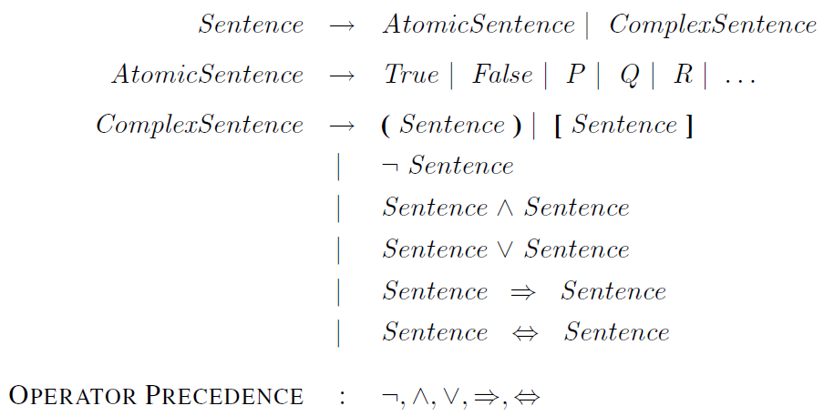
Syntax

Slide 17
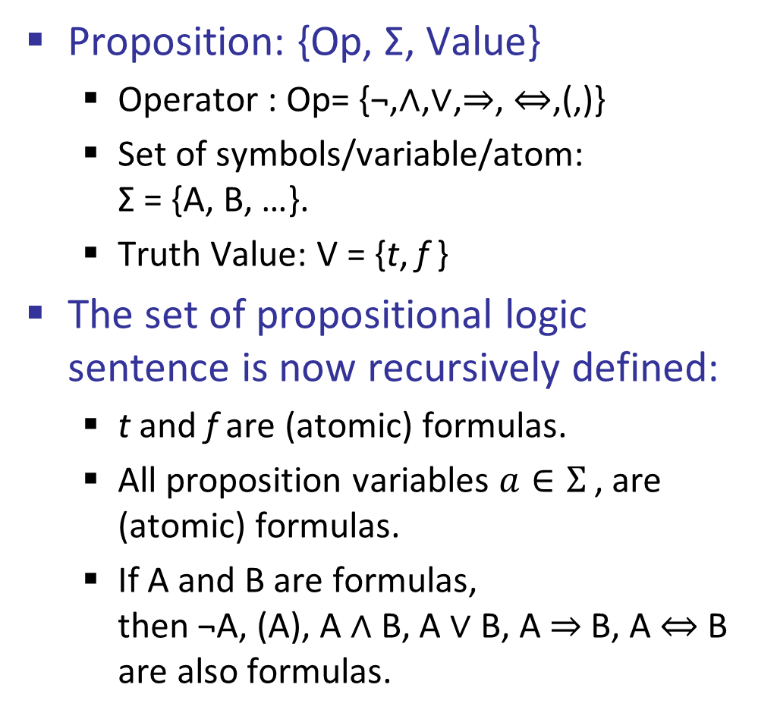
Syntax
Proposition: {Op, Σ, Value}
Operator : Op= {¬,∧,∨,⇒, ⇔,(,)}
Set of symbols/variable/atom: Σ = {A, B, …}.
Truth Value: V = {t, f }
The set of propositional logic sentence is now recursively defined:
t and f are (atomic) formulas.
All proposition variables $a∈Σ$, are (atomic) formulas.
If A and B are formulas, then ¬A, (A), A ∧ B, A ∨ B, A ⇒ B, A ⇔ B are also formulas.

Slide 18
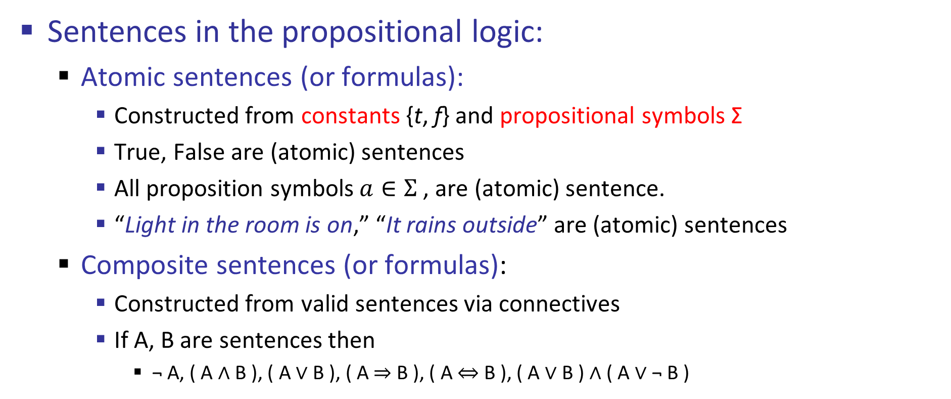
Syntax
Sentences in the propositional logic:
Atomic sentences (or formulas):
Constructed from constants {t, f} and propositional symbols Σ
True, False are (atomic) sentences
All proposition symbols $a∈Σ$, are (atomic) sentence.
“Light in the room is on,” “It rains outside” are (atomic) sentences
Composite sentences (or formulas):
Constructed from valid sentences via connectives
If A, B are sentences then
¬ A, ( A ∧ B ), ( A ∨ B ), ( A ⇒ B ), ( A ⇔ B ), ( A ∨ B ) ∧ ( A ∨ ¬ B )

Slide 19
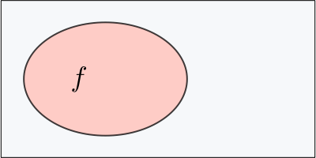
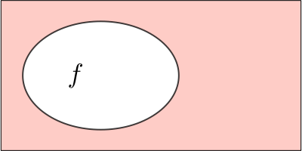
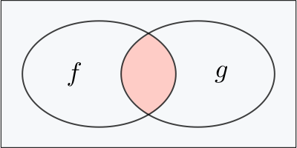
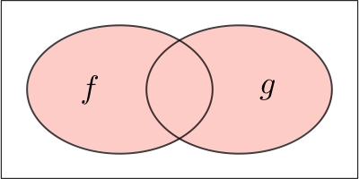
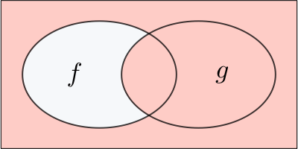
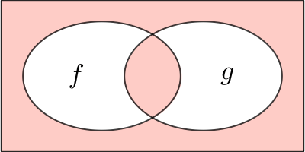
Syntax
Name | Symbol | Meaning | Illustration
Affirmation | f | f
Negation | ¬f | not f
Conjunction | f ∧ g | f and g
Disjunction | f ∨ g | f or g
Implication | f → g | if f then g
Biconditional | f ↔ g | f, that is to say g

Slide 20
Semantics
The semantic gives the meaning to sentences.
The semantics in the propositional logic is defined by:
Interpretation of propositional symbols and constants
Semantics of atomic sentences
Through the meaning of connectives
Meaning (semantics) of composite sentences

Slide 21
Semantics
The semantics of propositional calculus is defined below.
Interpretation:
A mapping function V : Σ → {t, f }, depending on whether the symbol is satisfied in the world
Assigns a truth value to every proposition variable.
Example: consider the two interpretation I₁ and I₂
I₁ : Light in the room is on -> True, It rains outside -> False
V(Light in the room is on, I₁) = True
I₂ : Light in the room is on -> False, It rains outside -> False
V(Light in the room is on, I₂) = False

Slide 22
Semantics
Interpretation:
A mapping function V : Σ → {t, f }, depending on whether the symbol is satisfied in the world
Assigns a truth value to every proposition variable.
Example:
Given three sentence
ai_is_fun
happy
light_on
Interpretation I₁:
V(ai_is_fun, I₁) = true
V(happy, I₁) = false
V(light_on, I₁) = true
Interpretation I₂:
V(ai_is_fun, I₂) = false
V(happy, I₂) = false
V(light_on, I₂) = false

Slide 23
Interpretation
Suppose there are three sentence
ai_is_fun
happy
light_on
Interpretation I₁:
V(ai_is_fun, I₁) = true
V(happy, I₁) = false
V(light_on, I₁) = true
Interpretation I₂:
V(ai_is_fun, I₂) = false
V(happy, I₂) = false
V(light_on, I₂) = false
ai_is_fun is true in I₁
¬ ai_is_fun is false in I₁
happy is false in I₁
¬happy is true in I₁
ai_is_fun ∨ happy is true in I₁
ai_is_fun ← happy is true in I₁
happy ← ai_is_fun is false in I₁
ai_is_fun ← happy ∧ light_on is true in I₁
ai_is_fun is false in I₂
¬ ai_is_fun is true in I₂
happy is true in I₂
¬happy is false in I₂
ai_is_fun ∨ happy is true in I₂
ai_is_fun ← happy is false in I₂
happy ← ai_is_fun is true in I₂
ai_is_fun ← happy ∧ light_on is true in I₂

Slide 24
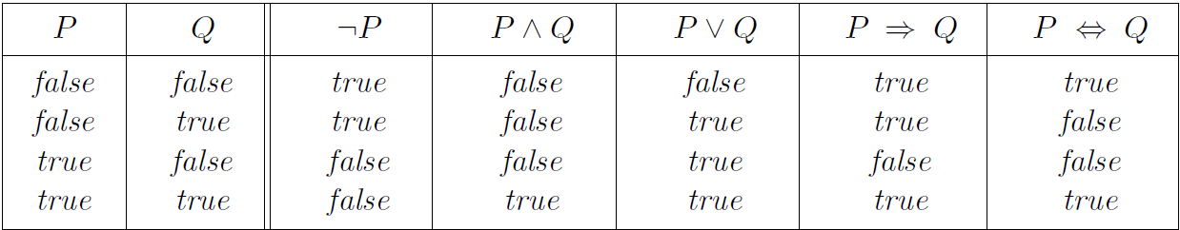
Semantics
For complex sentences
Determined using the standard rules of logic
Rows define all possible interpretations (worlds)

Slide 25
Example
Given a sentence
“If the humidity is high and the temperature is high, then one does not feel comfortable”
Propositional Calculus:
“Humidity is high” ∧ “Temperature is high” ⇒ “One feels comfortable”.

Slide 26
Example
Given a sentence
“If the humidity is high and the temperature is high, then one does not feel comfortable”
We have the following sentences:
P: “Humidity is high”
Q: “Temperature is high”
R: “One feels comfortable”.
Represented by: ((P∧Q)⇒(~R))
In which interpretation sentence is false
P | Q | R | P ∧ Q | ~R | P ∧ Q → ~R
T | T | T | T | F | F
T | T | F | T | T | T
T | F | T | F | F | T
T | F | F | F | T | T
F | T | T | F | F | T
F | T | F | F | T | T
F | F | T | F | F | T
F | F | F | F | T | T
P | Q | R | P ∧ Q | ~R | P ∧ Q → ~R
T | T | T | T | F | F
T | T | F | T | T | T
T | F | T | F | F | T
T | F | F | F | T | T
F | T | T | F | F | T
F | T | F | F | T | T
F | F | T | F | F | T
F | F | F | F | T | T

Slide 27
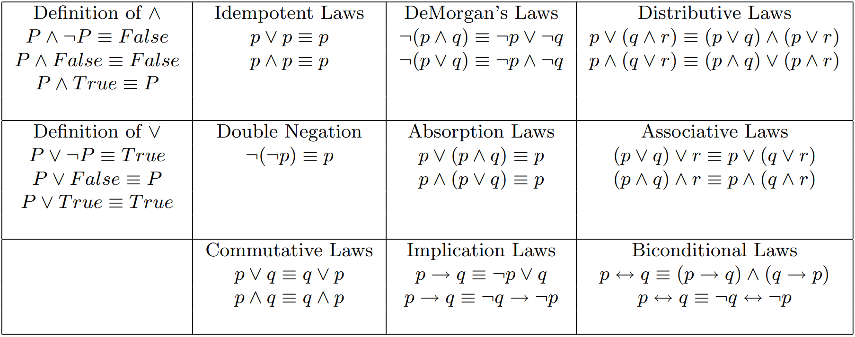
Properties: Logical equivalence
Two propositions are said to be logically equivalent if and only if the columns in the truth table are identical to each other.

Slide 28
Properties
A proposition sentence:
Tautology iff sentence is true under every interpretation, e.g., (P V ¬ P)
Contradiction iff sentence is false under every interpretation, e.g., (P ∧ ¬ P)
Consistent / Satisfiable iff sentence is true under at least one interpretation
Inconsistent / Unsatisfiable iff sentence is not made true under any interpretation

Slide 29
Interpretations and Models
Every interpretation that satisfies a sentence is called a model of the sentence.
A sentence is satisfiable if it has a model
There is at least one interpretation under which the sentence can evaluate to True.
A sentence is valid if it is True in all interpretations
i.e., if its negation is not satisfiable (leads to contradiction)
P | Q | P ∨ Q | (P ∨ Q) ∧ ¬Q | ((P ∨ Q) ∧ ¬Q) ⇒ P
T | T | T | F | T
T | T | T | T | T
T | F | T | F | T
T | F | F | F | T

Slide 30
Knowledge Base
A knowledge base (KB) is a set of propositions that the agent is given as being true. An element of the knowledge base is an axiom.
A model of a set of propositions is an interpretation in which all the propositions are true.
Example KB: {A ∨ C, B ∨ ¬C}
KB = (A ∨ C) ∧ (B ∨ ¬C)
A | B | C | A ∨ C | B ∨ ¬C | KB
T | T | T | T | T | T
T | T | F | T | T | T
T | F | T | T | F | F
T | F | F | T | T | T
F | T | T | T | T | T
F | T | F | F | T | F
F | F | T | T | F | F
F | F | F | F | T | F
A | B | C | A ∨ C | B ∨ ¬C | KB
T | T | T | T | T | T
T | T | F | T | T | T
T | F | T | T | F | F
T | F | F | T | T | T
F | T | T | T | T | T
F | T | F | F | T | F
F | F | T | T | F | F
F | F | F | F | T | F

Slide 31
Propositional Inference: Entailment
Given:
KB = set of propositional sentences
α = a propositional sentence / Query / Ask question
Entailment: KB ╞ α (read as “KB entails α” or “α logically follows from KB”)
iff α is true in every model of KB
OR
iff every interpretation that makes all sentences in KB true makes α also true.
OR
iff every model of KB is also a model of α

Slide 32
Propositional Inference: Entailment
Given:
KB = set of propositional sentences = {A ∨ C, B ∨ ¬C}
α = a propositional sentence = A ∨ B
Entailment: KB ╞ α
That is, no interpretation exists in
which KB is true and α is false.
A | B | C | A ∨ C | B ∨ ¬C | KB
T | T | T | T | T | T
T | T | F | T | T | T
T | F | T | T | F | F
T | F | F | T | T | T
F | T | T | T | T | T
F | T | F | F | T | F
F | F | T | T | F | F
F | F | F | F | T | F
A | B | C | A ∨ C | B ∨ ¬C | KB | α
T | T | T | T | T | T | T
T | T | F | T | T | T | T
T | F | T | T | F | F | T
T | F | F | T | T | T | T
F | T | T | T | T | T | T
F | T | F | F | T | F | T
F | F | T | T | F | F | F
F | F | F | F | T | F | F

Slide 33
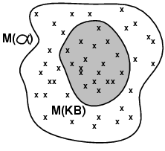
Model
Semantics in Logic is in terms of Models: formally structured worlds with respect to which truth can be evaluated
A model m denotes an assignment of binary weights to propositional symbols.
If a Sentence α is true in model m
m satisfies α (m is model of α)
M(α): Set of all models of α

Slide 34
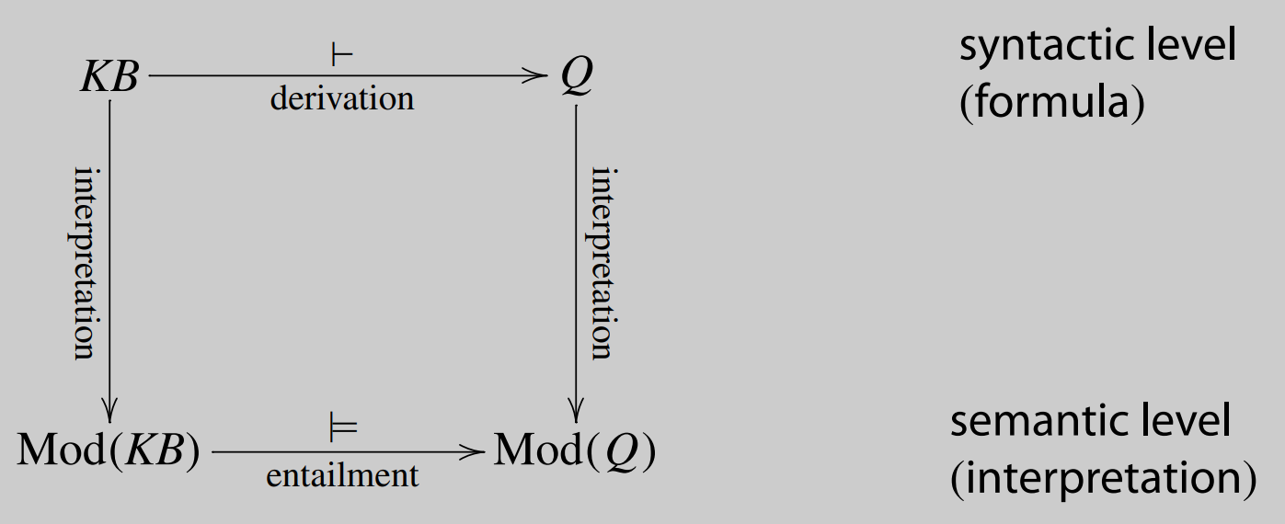
Inference and Entailment

Slide 35
Inference and Entailment
Entailment reflects the relation of one fact in the world following from the others according to logic
Knowledge base KB entails sentence α iff α is true in all worlds where KB is true
sentences
sentences
Representation
entails
Semantics
(interpretation)
Real World
follows
facts
facts

Slide 36
Inference Procedures
Inference is a process by which conclusions are reached.
We want to implement the inference process on a computer !!
KB ├_{i} α
Sentence α can be inferred/derived/deduct from KB by procedure i
i derived α from KB
Algorithmic procedure that manipulate sentences in the input KB to produce α as an output

Slide 37
Inference Procedures Properties
Soundness: i is sound if whenever KB ├_{i} α, then KB╞ α
No wrong inferences but maybe not all true statements can be derived
Derives only entailed sentences
Completeness: i is complete if whenever KB╞ α, then KB ├_{i} α
All true sentences can be derived, but maybe some wrong extra ones as well
Derive any sentence that is entailed
A | B | C | A ∨ C | B ∨ ¬C | KB | α
T | T | T | T | T | T | T
T | T | F | T | T | T | T
T | F | T | T | F | F | T
T | F | F | T | T | T | T
F | T | T | T | T | T | T
F | T | F | F | T | F | T
F | F | T | T | F | F | F
F | F | F | F | T | F | F

Slide 38
Logical Inference Problem Formulation
Given:
KB = set of propositional sentences
α = a propositional sentence / Query / Ask question
Does a KB semantically entail ? KB ╞ α ?
Question: Is there a procedure (program) that can decide this problem in a finite number of steps?
Answer: Yes. Logical inference problem for the propositional logic is decidable.

Slide 39
Inference: proofs
How we design the sound and complete procedure that answers:
KB ╞ α ?
Method 1: model-checking
For every possible world, if KB is true make sure that is α true too
OK for propositional logic (finitely many worlds); not easy for first-order logic
Method 2: theorem-proving
Search for a sequence of proof steps (applications of inference rules) leading from KB to α
E.g., from P ∧ (P ⇒ Q), infer Q by Modus Ponens

Slide 40
Inference: Model Checking
Given:
KB = set of propositional sentences = {A ∨ C, B ∨ ¬C}
α = a propositional sentence = A ∨ B
Entailment: KB ╞ α
A | B | C | A ∨ C | B ∨ ¬C | KB
T | T | T | T | T | T
T | T | F | T | T | T
T | F | T | T | F | F
T | F | F | T | T | T
F | T | T | T | T | T
F | T | F | F | T | F
F | F | T | T | F | F
F | F | F | F | T | F
A | B | C | A ∨ C | B ∨ ¬C | KB | α
T | T | T | T | T | T | T
T | T | F | T | T | T | T
T | F | T | T | F | F | T
T | F | F | T | T | T | T
F | T | T | T | T | T | T
F | T | F | F | T | F | T
F | F | T | T | F | F | F
F | F | F | F | T | F | F

Slide 41
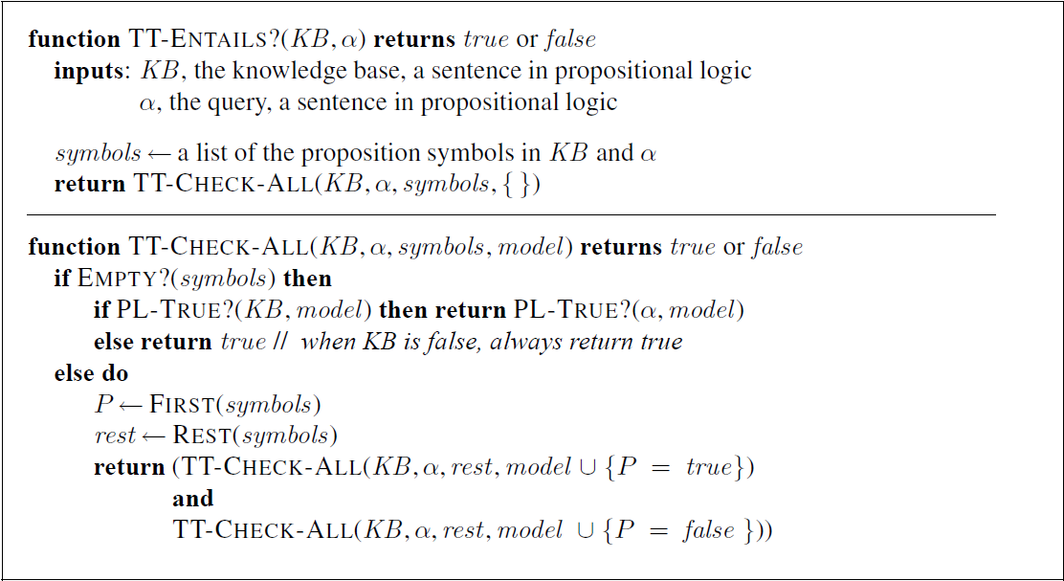
Inference by enumeration
Depth-first enumeration of all models is sound and complete
PL-True returns true if the sentence holds within the model
For n symbols, time complexity is O(2^{n}), space complexity is O(n)

Slide 42
Inference: Model Checking
Problem given:
KB = set of propositional sentences
α = a propositional sentence / Query / Ask question
KB ╞ α ?
We need to check all possible interpretations for which the KB is true (models of KB) whether α is true for each of them
Truth table:
Enumerates truth values of sentences for all possible interpretations (assignments of True/False values to propositional symbols)
Limitation:
The method of truth tables is a very inefficient since we need to evaluate a formula for each of 2^{n} possible models (interpretations), where n is the number of distinct atoms in the formula.

Slide 43

Inference Rule for Logic
Modus ponens
← premise
← conclusion
If both sentences in the premise are true then conclusion is true.
The modus ponens inference rule is sound.
We can prove this through the truth table.
$$\frac{p⇒q, p}{q}$$
p | q | p ⇒ q | p ⇒ q ∧ p
T | T | T | T
T | F | F | F
F | T | T | F
F | F | T | F
p | q | p ⇒ q | p ⇒ q ∧ p
T | T | T | T
T | F | F | F
F | T | T | F
F | F | T | F

Slide 44
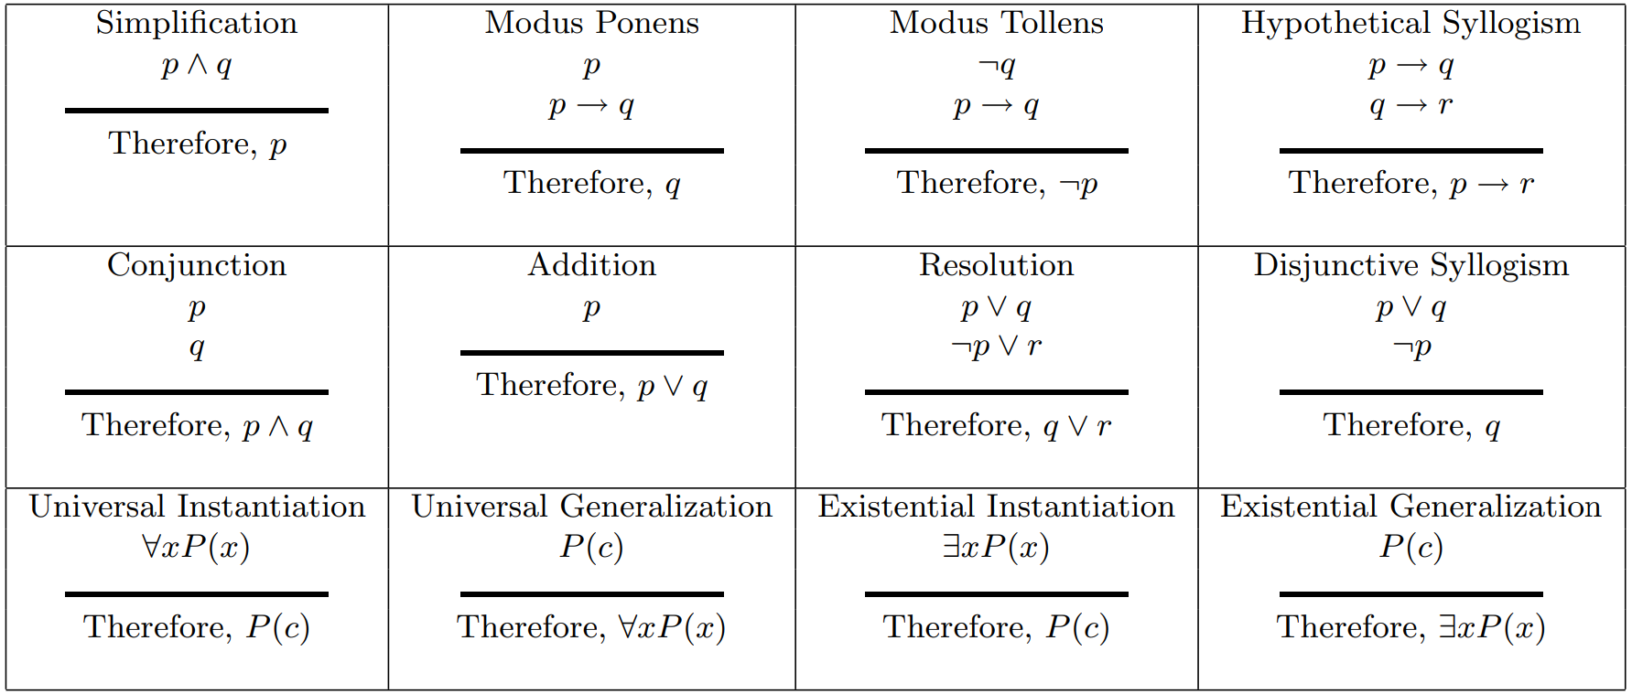
Rule of Inference
Generating the conclusions from evidence and facts is termed as Inference.

Slide 45



Theorem Proving: Inference Rule
Checks only entries for which KB is True.
Represent sound inference patterns repeated in inferences
Can be used to generate new (sound) sentences from the existing ones
(MP) Modes Ponens
(AI) And-Introduction
(OI) Or-Introduction
(AE) And-Elimination
(NE) Negation-Elimination
(UR) Unit Resolution
(R) General Resolution

Slide 46
Using Inference Rules
Given: KB = {(A ∨ B) ⇒ C ∧ (B ∨ ¬D)), A ∧ D }
Prove: (B ∨ D) ∧ C
(A ∨ B) ⇒ C ∧ (B ∨ ¬D)
A ∧ D
(A ∨ B) ⇒ C : Using 1 and AE
A : Using 2 and AE
B ∨ ¬D : Using 1 and AE
D : Using 2 and AE
B : Using 5, 6 and UR
A ∨ B : Using 4, 7 and OI
C : Using 3, 8 and MP
B ∨ D : Using 6, 7 and OI
(B ∨ D) ∧ C : Using 9, 10 and AI
Note: in each of the steps in the proof we could have applied other rules to derive new sentences, thus the inference problem is really a search problem:
Initial state = KB
Goal state = conclusion to be proved
Operators = ?

Slide 47
Example
Given: KG = {P ∧ Q, P ⇒ R, (Q ∧ R) ⇒ S}
Prove: KG╞ S
P ∧ Q
P ⇒ R
(Q ∧ R) ⇒ S
P : Using 1 and AE
R : Using 2, 4 and MP
Q : Using 1, and AE
(Q ∧ R) : Using 5, 6 and AI
S : Using 3, 7 and MP

Slide 48
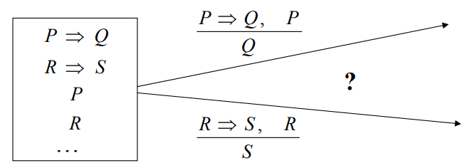
Logic inferences and search
To show that sentence holds for a KB
we may need to apply a number of sound inference rules
Problem: many possible rules can be applied in the next step
This is an instance of a search problem:
Truth table method (from the search perspective)
blind enumeration and checking

Slide 49
Propositional Definite Clauses
An atomic proposition or atom (or facts) is the same as in propositional calculus.
A body is an atom or a conjunction of atoms. a ∧ b
A definite clause is either an atom a, called an atomic clause, or of the form a ⇒ b, called a rule,
where b, the head, is an atom and a is a body.
A knowledge base is a set of definite clauses.
If “a₁ ∧ ... ∧ a_{m} ⇒ b” is a definite clause in the knowledge base,
each KB╞ a_{i}, then KB╞ b.

Slide 50
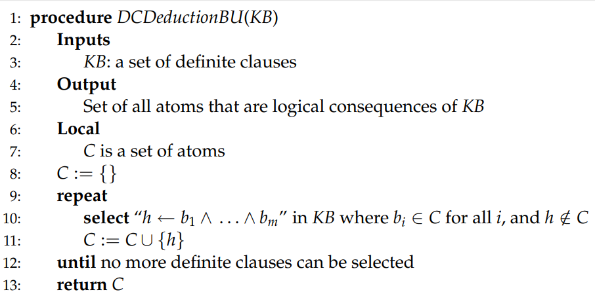
Bottom-up Proof Procedure: Forward Chaining
If “h ← b₁ ∧ ... ∧ b_{m}” is a definite clause in the knowledge base,
each b_{i} has been derived,
then h can be derived.

Slide 51
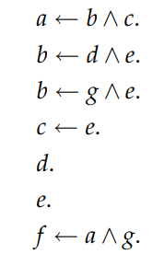
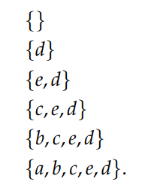
Example
KB KB╞ a
a
c
b
e d

Slide 52
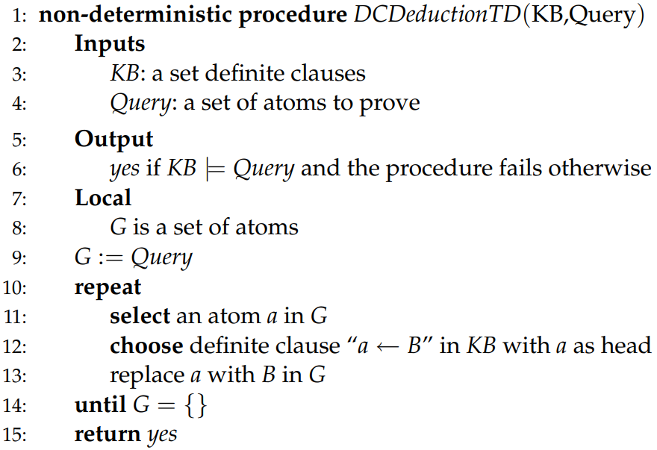
Top-Down Proof Procedure: Backward Chaining

Slide 53
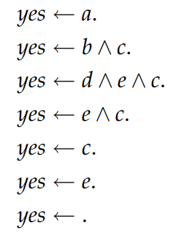
Example
KB KB╞ a
a
c
b
e d

Slide 54
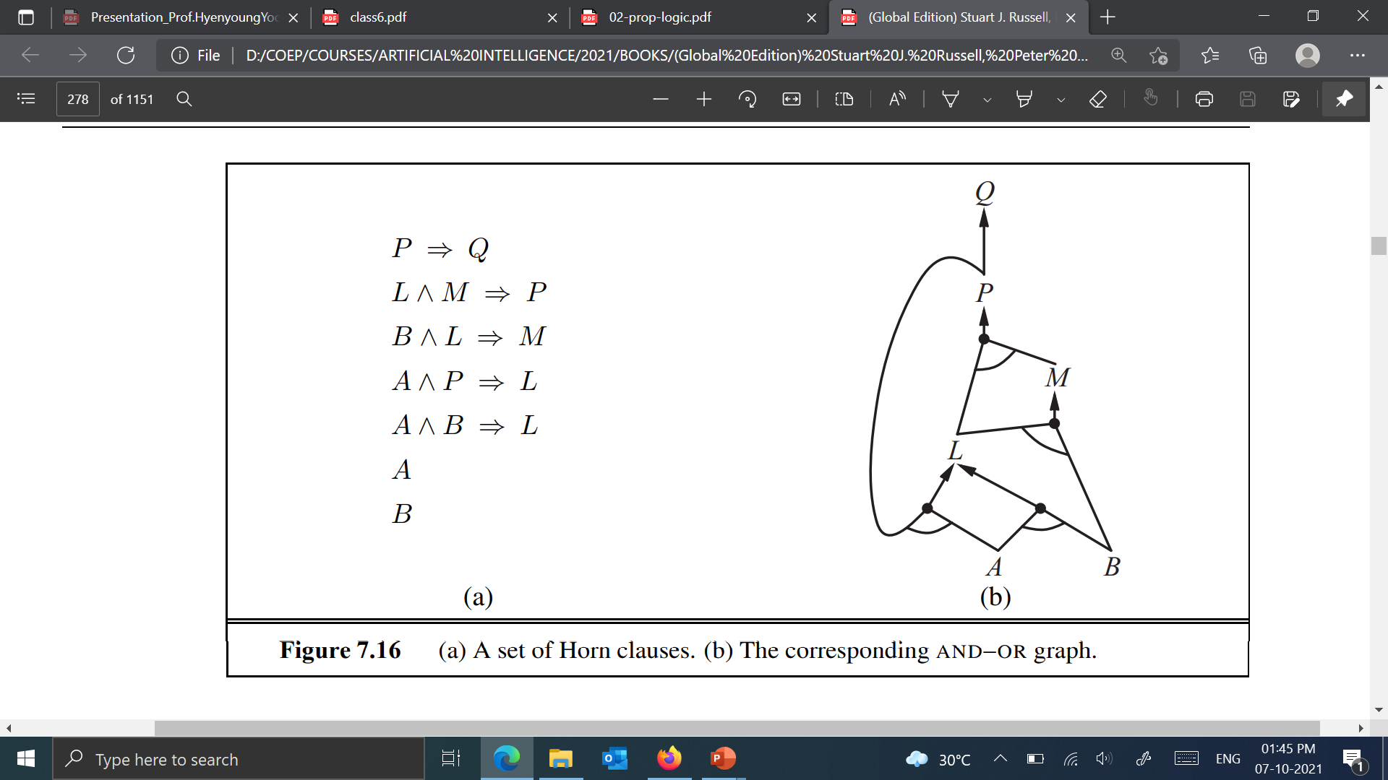
Example
KB KB╞ Q

Slide 55
Example
Assume the KB with the following rules and facts
KB: R1: A ∧ B ⇒ C α = E?
R2: C ∧ D ⇒ E
R3: C ∧ F ⇒ G
F1: A
F2: B
F3: D

Slide 56
Example
Given: KB
sam_is_happy.
ai_is_fun.
worms_live_underground.
Night_time.
bird_eats_apple.
bird_eats_apple ⇒ apple_is_eaten .
sam_is_in_room ∧ night_time ⇒ switch_1_is_up .
Prove:
KB ╞ bird_eats_apple.
KB ╞ apple_is_eaten.
KB ╞ switch_1_is_up
Until we consider computers with perception and the ability to act in the world
The computer does not know the meaning of the symbols.
It is the human that gives the symbols meaning.
All the computer knows about the world is what it is told about the world.

Slide 57
Proof Procedure
Bottom-Up proof Approach
Forword Chaining
Work forward from KB to query α:
Fire any rule whose premises are satisfied in the KB
Add its conclusion to the KB, until query α is found
Data-driven, automatic, unconscious processing,
e.g., object recognition, routine decisions
Top-Down proof Approach
Backward Chaining
Work backwards from the query α to KB:
Check if α is known already, or
Prove by BC all premises of some rule concluding α
Goal-driven, appropriate for problem-solving
e.g., Where are my keys? How do I get into a PhD program?
Complexity of BC can be much less than linear in size of KB

Slide 58

Sentence transformations
Propositional logic:
A sentence may include connectives: ¬ ∨ ∧ ⟹ ⇔
A sentence may consist of multiple nested sentences
Do we need all operators to represent a complex sentence?
No. We can rewrite a sentence in PL using an equivalent sentence with just operators
Is it possible to limit the depth of the sentence structure?
Yes. Example: Normal forms.
$$¬∨ ∧ ⟹ ⇔$$

Slide 59
Normal forms
Normal forms: This can simplify the inferences.
Conjunctive normal form (CNF)
Conjunction of clauses (clauses include disjunctions of literals)
(A ∨ B) ∧ (¬A ∨ ¬C ∨ D)
Disjunctive normal form (DNF)
Disjunction of terms (terms include conjunction of literals)
(A ∧ ¬B) ∨ (¬A ∧ C) ∨ (C ∧ ¬D)

Slide 60
Conversion to CNF
Given: A ⇔ (B ∨ C)
Eliminate ⇔, replacing α ⇔ β with (α ⇒ β)∧(β ⇒ α).
(A ⇒ (B ∨ C)) ∧ ((B ∨ C) ⇒ A)
2. Eliminate ⇒, replacing α ⇒ β with ¬α ∨ β.
(¬A ∨ B ∨ C) ∧ (¬(B ∨ C) ∨ A)
3. Move ¬ inwards using DeMorgan's rules and double-negation:
(¬A ∨ B ∨ C) ∧ ((¬ B ∧ ¬ C) ∨ A)
4. Apply distributivity law (∧ over ∨) and flatten:
(¬A ∨ B ∨ C) ∧ (¬ B ∨ A) ∧ (¬ C ∨ A)

Slide 61
Properties: Logical equivalence
Two propositions are said to be logically equivalent if and only if the columns in the truth table are identical to each other.

Slide 62
Example
Given: ¬(A ⇒ B) ∨ (C ⇒ A)
¬(¬A ∨ B) ∨ (¬C ∨ A)
(A ∧ ¬B) ∨ (¬C ∨ A)
( A ∨ ¬C ∨ A) ∧ (¬B ∨ ¬C ∨ A)
( A ∨ ¬C) ∧ (¬B ∨ ¬C ∨ A)
Given: (P ⇒ (Q ⇒ R)) ⇒ (P ⇒ (R ⇒ Q))
¬(¬P ∨ ¬Q ∨ R) ∨ (¬P ∨ ¬R ∨ Q)
(P ∧ Q ∧ ¬R) ∨ (¬P ∨ ¬R ∨ Q)
(P ∨ ¬P ∨ ¬R ∨ Q) ∧ (Q ∨ ¬P ∨ ¬R ∨ Q) ∧ (¬R ∨ ¬P ∨ ¬R ∨ Q)

Slide 63
Satisfiability (SAT) problem
Determine whether a sentence in the conjunctive normal form (CNF) is satisfiable (i.e. can evaluate to true)
(P ∨ Q ∨ ¬R) ∧ (¬P ∨ ¬R ∨ S ) ∧ (¬P ∨ Q ∨ ¬T )
It is an instance of a constraint satisfaction problem (CSP):
Variables
Propositional symbols (P, R, T, S)
Values: True, False
Constraints
Every conjunct must evaluate to true, at least one of the literals must evaluate to true

Slide 64
Solving SAT
Methods:
Backtracking: equivalent to the depth first search
Pick the variable, then pick its value (T or F)
Continue till all variables are assigned or till the partial assignment makes the sentence False
Iterative optimization methods:
Start from an arbitrary assignment of T, F values to symbols
Flip T, F values for one variable
Heuristics: prefer assignments that make more clauses true
Walk-SAT, simulated-annealing procedures

Slide 65
Inference problem and satisfiability
Logical inference problem:
We want to show that the sentence α is entailed by KB: KB ╞ α
For all interpretations for which KB is true α is also true?
Satisfiability (SAT) problem:
Is there is some assignment (interpretation) under which the sentence α evaluates to true?
Is it possible to formulate a logical inference problem as a satisfiability problem?

Slide 66
Inference problem and satisfiability
Logical inference problem:
For all interpretations for which KB is true α is also true?
Satisfiability:
Is there is some assignment (interpretation) under which a sentence evaluates to true
Connection:
KB ╞ α if and only if (KB ∧ ¬ α ) is unsatisfiable
Consequences:
Inference problem is NP-complete
Programs for solving the SAT problem can be used to solve the inference problem

Slide 67
Inferences with the CNF
Is there an inference rule that is sufficient to support all inferences for the KB in the CNF form?
A rule that seems to fit very well the CNF form is the resolution rule.

Slide 68
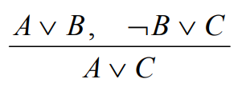
Resolution rule
Resolution rule
Sound inference rule that works for the KB in the CNF form
KB
α
A | B | C | A ∨ B | ¬B ∨ C | KB | α
T | T | T | T | T | T | T
T | T | F | T | F | F | T
T | F | T | T | T | T | T
T | F | F | T | T | T | T
F | T | T | T | T | T | T
F | T | F | T | F | F | F
F | F | T | F | T | F | T
F | F | F | F | T | F | F

Slide 69
Inferences with the resolution rule
Resolution rule is sound
Is it complete?
Is it possible to use it such that we start from the KB
Then prove the new facts and eventually prove the theorem if it is entailed?
Not always = incomplete
Repeated application of the resolution rule to a KB in CNF may fail to derive new valid sentences
Example: We know: (A ∧ B) We want to show: (A ∨ B)
Resolution rule fails to derive it (incomplete ??)

Slide 70
Satisfiability inferences with the resolution rule
Conversion to SAT:
Proof by contradiction
Disproving: ( KB ∧ ¬α )
Proves the entailment Important: KB ╞ α
Important
Resolution rule is sufficient to determine satisfiability/unsatisfiability of
(KB ∧ ¬ α )
For any KB and Query in the CNF
We say the resolution rule is refutation complete.

Slide 71
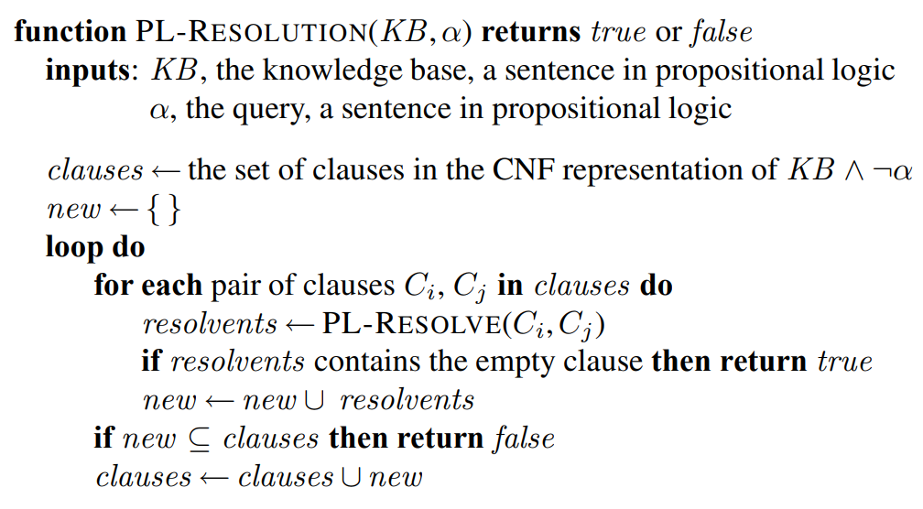
Resolution algorithm
Algorithm:
Convert KB to the CNF form;
Apply iteratively the resolution rule starting from
( KB ∧ ¬α ) (in CNF form)
Stop when:
Contradiction (empty clause) is reached:
A ,¬ A → Ø
proves entailment.
No more new sentences can be derived
disproves it.

Slide 72
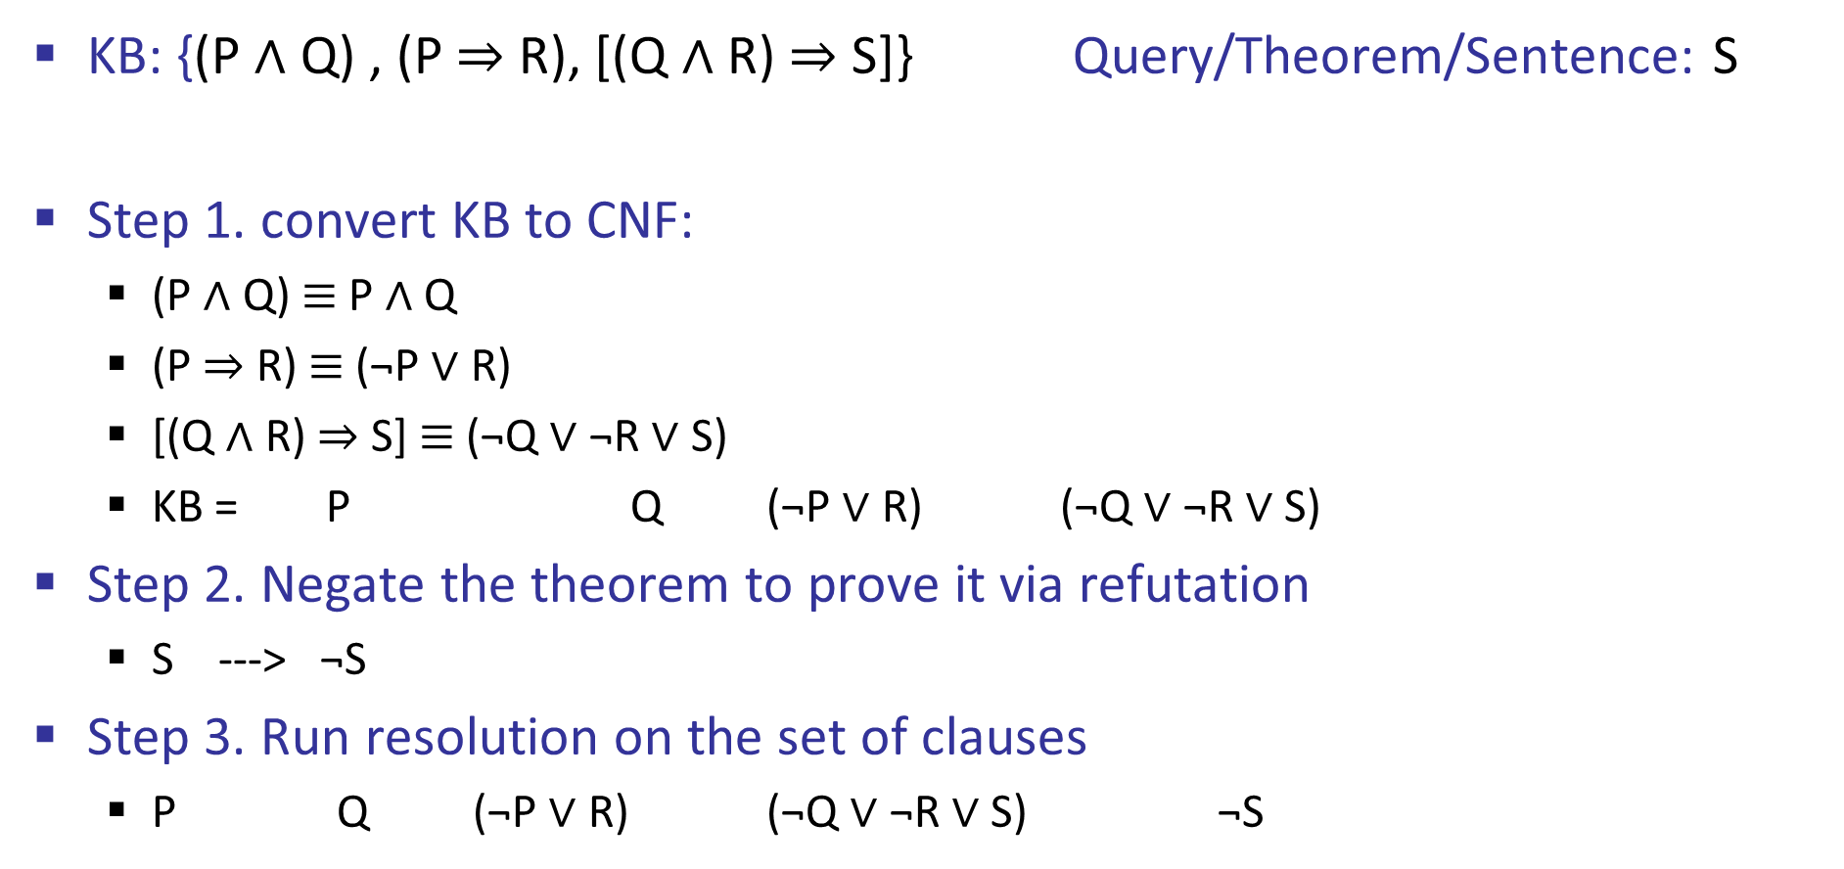
Example
KB: {(P ∧ Q) , (P ⇒ R), [(Q ∧ R) ⇒ S]} Query/Theorem/Sentence: S
Step 1. convert KB to CNF:
(P ∧ Q) $≡$ P ∧ Q
(P ⇒ R) $≡$ (¬P ∨ R)
[(Q ∧ R) ⇒ S] $≡$ (¬Q ∨ ¬R ∨ S)
KB = P Q (¬P ∨ R) (¬Q ∨ ¬R ∨ S)
Step 2. Negate the theorem to prove it via refutation
S ---> ¬S
Step 3. Run resolution on the set of clauses
P Q (¬P ∨ R) (¬Q ∨ ¬R ∨ S) ¬S

Slide 73
Example
KB: {(P ∧ Q) , (P ⇒ R), [(Q ∧ R) ⇒ S]} Theorem/Sentence: S
P Q (¬P ∨ R) (¬Q ∨ ¬R ∨ S) ¬S
R
¬R ∨ S
S
Contradiction →
{ }
→ KB ╞ S

Slide 74
Example
Knowledge Base:
The humidity is high or the sky is cloudy.
If the sky is cloudy, then it will rain.
If the humidity is high, then it is hot.
It is not hot.
Query: It will rain.

Slide 75
Formulate the Problem
P: Humidity is high
Q: Sky is cloudy
R: It will rain
S: It is hot
The humidity is high or the sky is cloudy :
If the sky is cloudy, then it will rain :
If the humidity is high, then it is hot :
It is not hot :
CNF
P V Q
(¬Q V R)
(¬P V S) ¬S
P V Q
Q ⇒ R
P ⇒ S
¬S

Slide 76
Resolution
KB
P V Q
(¬Q V R)
(¬P V S)
¬S
Query :
¬R
P V Q ¬Q V R
P V R
¬P V S
R V S
¬S
R
¬R
{ }

Slide 77
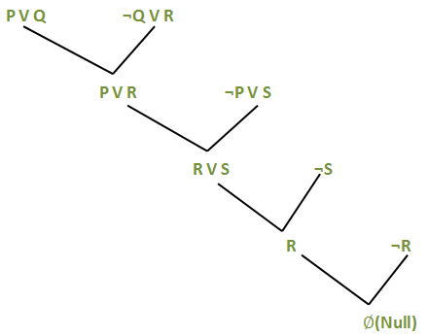
Resolution
KB
P V Q
(¬Q V R)
(¬P V S)
¬S
Query :
¬R

Slide 78
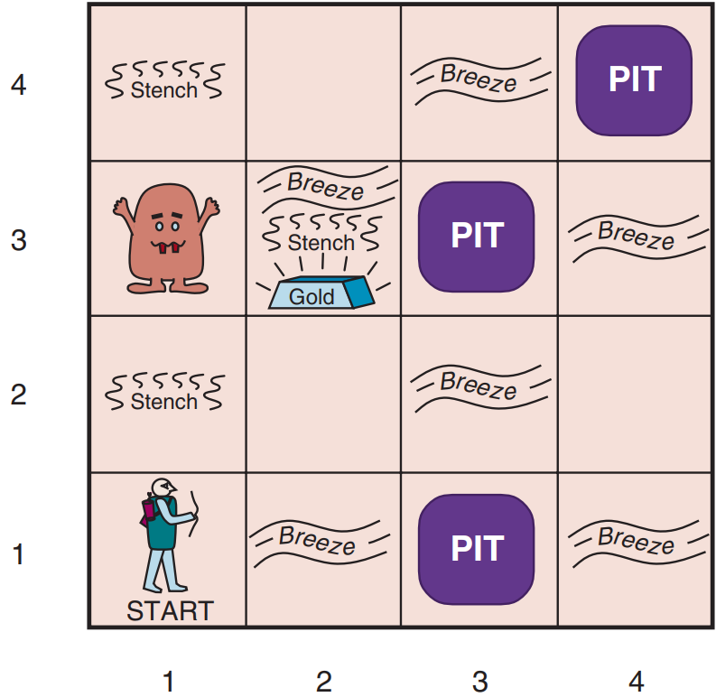
Wumpus World PEAS description
Performance measure
gold +1000, death -1000
-1 per step, -10 for using the arrow
Environment
Squares adjacent to wumpus are smelly
Squares adjacent to pit are breezy
Glitter iff gold is in the same square
Shooting kills wumpus if you are facing it
Shooting uses up the only arrow
Grabbing picks up gold if in same square
Releasing drops the gold in same square
Sensors: Stench, Breeze, Glitter, Bump, Scream
Actuators: Left turn, Right turn, Forward, Grab, Release, Shoot

Slide 79
Wumpus world characterization
Fully Observable
Deterministic
Episodic
Static
Discrete
Single-agent?
No – only local perception
Yes – outcomes exactly specified
No – sequential at the level of actions
Yes – Wumpus and Pits do not move
Yes
Yes – Wumpus is essentially a natural feature

Slide 80
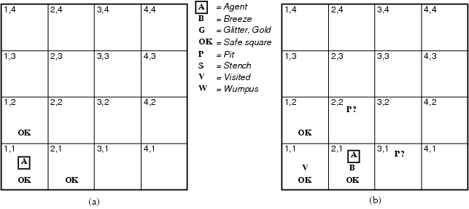
Exploring the Wumpus World
The KB initially contains the rules of the environment.
[1,1] : [none,none,none,none,none], Move to safe cell e.g. [2,1]
[2,1] :[none,Breeze,none,none,none]
There is a pit in [2,2] or [3,1]
Return to [1,1] to try next safe cell

Slide 81
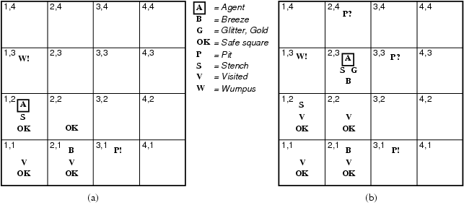
Exploring the Wumpus World
[1,2] : [Stench,none,none,none,none]
Wumpus is in [1,3] or [2,2] YET … not in [1,1]
Thus … not in [2,2] or stench would have been detected in [2,1]
Thus … wumpus is in [1,3]
Thus … [2,2] is safe because of lack of breeze in [1,2]
Thus … pit in [3,1]
Move to next safe cell [2,2]

Slide 82
Exploring the Wumpus World
[2,2] : [none,none,none,none,none]
Move to next safe cell [2,3]

Slide 83
Exploring the Wumpus World
[2,3] : [Stench,Breeze,Glitter,none,none]
Thus… pick up gold
Thus… pit in [3,3] or [2,4]

Slide 84
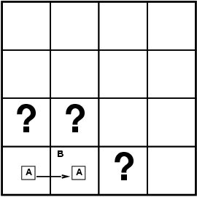
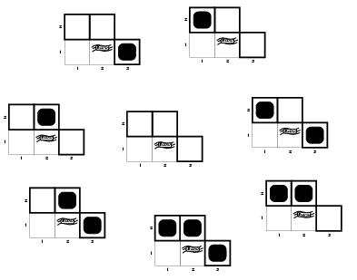
Entailment in the wumpus world
Situation after detecting nothing in [1,1], moving right, breeze in [2,1]
Consider possible models for KB assuming only pits
3 Boolean choices ⇒ 8 possible models

Slide 85
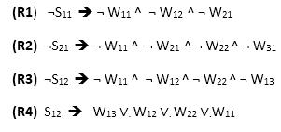
Atomic proposition variable and rules for Wumpus world
Let P_{i,j} be true if there is a Pit in the room [i, j].
Let B_{i,j} be true if agent perceives breeze in [i, j], (dead or alive).
Let W_{i,j} be true if there is wumpus in the square[i, j].
Let S_{i,j} be true if agent perceives stench in the square [i, j].
Let V_{i,j} be true if that square[i, j] is visited.
Let G_{i,j} be true if there is gold (and glitter) in the square [i, j].
Let OK_{i,j} be true if the room is safe.

Slide 86

Representation of Knowledge for Wumpus world
Following is the Simple KB for wumpus world when an agent moves from room [1, 1], to room [2,1]:

Slide 87
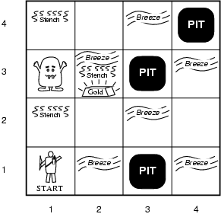
Wumpus world Entailment by Model-Checking
There is no pit in [1,1]:
R1 : ¬P_{1,1}
Rule:
R2 : B_{1,1} ⇔ (P_{1,2} ∨ P_{2,1})
R3 : B_{2,1} ⇔ (P_{1,1} ∨ P_{2,2} ∨ P_{3,1})
Percepts for the first two squares visited in the specific world the agent:
R4 : ¬B_{1,1}
R5 : B_{2,1}
¬P_{1,2} entailed by our KB?
symbols are B_{1,1}, B_{2,1}, P_{1,1}, P_{1,2}, P_{2,1}, P_{2,2}, and P_{3,1}

Slide 88
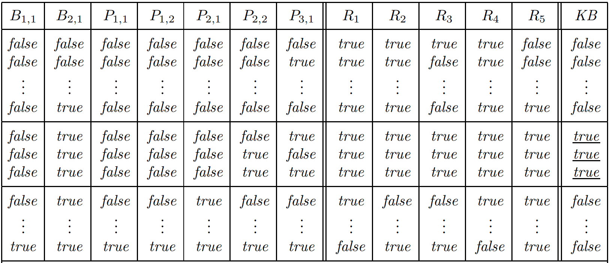
Truth table constructed for the Knowledge Base

Slide 89
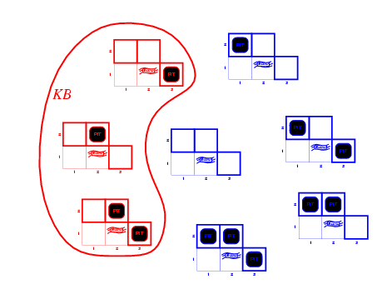
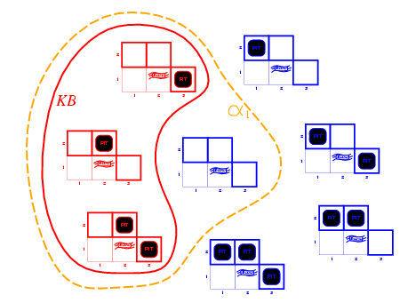
Wumpus models
KB = wumpus-world rules + observations
α₁ = "[1,2] is safe",
KB ╞ α₁, proved by model checking
In every model in which KB is true, α₁ is also true.

Slide 90
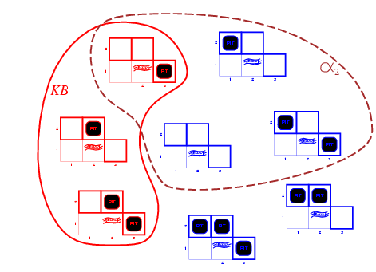
Wumpus models
KB = wumpus-world rules + observations
α₂ = "[2,2] is safe",
KB ╞ α₂
The agent cannot conclude that there is no pit in [2,2] (Nor can it conclude that there is a pit in [2,2])

Slide 91
Inference by Theorem Proving
There is no pit in [1,1]:
R1 : ¬P_{1,1}
Rule:
R2 : B_{1,1} ⇔ (P_{1,2} ∨ P_{2,1})
R3 : B_{2,1} ⇔ (P_{1,1} ∨ P_{2,2} ∨ P_{3,1})
Percepts:
R4 : ¬B_{1,1}
R5 : B_{2,1}
¬P_{1,2} entailed by our KB?
Biconditional elimination to R2:
R6 : (B_{1,1} ⇒ (P_{1,2} ∨ P_{2,1})) ∧ ((P_{1,2} ∨ P_{2,1}) ⇒ B_{1,1})
And-Elimination to R6:
R7 : ((P_{1,2} ∨ P_{2,1}) ⇒ B_{1,1})
Logical equivalence for contrapositives:
R8 : (¬B_{1,1} ⇒ ¬(P_{1,2} ∨ P_{2,1}))
Modus Ponens with R8 and the percept R4 (i.e., ¬B_{1,1}):
R9 : ¬(P_{1,2} ∨ P_{2,1})
De Morgan’s rule to R9:
R10 : ¬P_{1,2} ∧ ¬P_{2,1}
That is, neither [1,2] nor [2,1] contains a pit

Slide 92
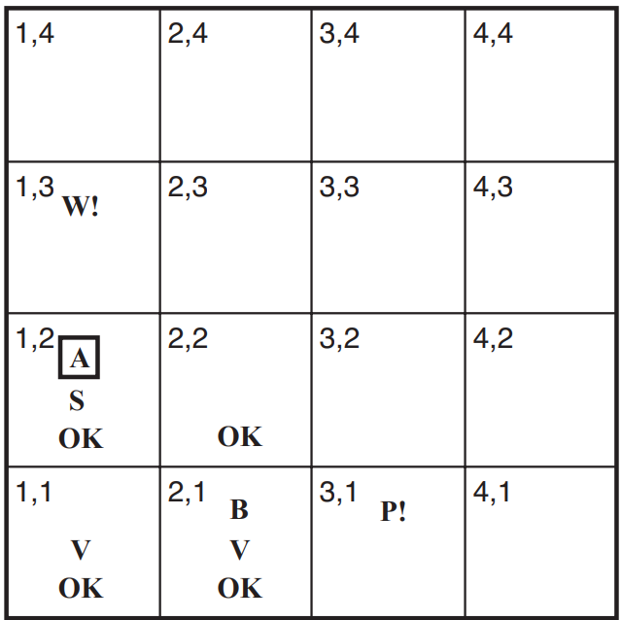
Resolution in Wumpus World
R11 : ¬B_{1,2}
R12 : B_{1,2} ⇔ (P_{1,1} ∨ P_{2,2} ∨ P_{1,3})
By the same process that led to R10 earlier, derive the absence of pits in [2,2] and [1,3] (remember R1 : ¬P_{1,1} is in KB) :
R13 : ¬P_{2,2}
R14 : ¬P_{1,3}
Apply biconditional elimination to R3 : B_{2,1} ⇔ (P_{1,1} ∨ P_{2,2} ∨ P_{3,1}) followed by Modus Ponens with R5
R15 : P_{1,1} ∨ P_{2,2} ∨ P_{3,1}
Resolution: literal ¬P_{2,2} in R13 resolves with the literal P_{2,2} in R15
R16 : P_{1,1} ∨ P_{3,1}
Resolution: literal ¬P_{1,1} in R1 resolves with the literal P_{1,1} in R16
R17 : P_{3,1}

Slide 93
Inference by Theorem Proving
There is no pit in [1,1]:
R1 : ¬P_{1,1}
Rule:
R2 : B_{1,1} ⇔ (P_{1,2} ∨ P_{2,1})
R3 : B_{2,1} ⇔ (P_{1,1} ∨ P_{2,2} ∨ P_{3,1})
Percepts:
R4 : ¬B_{1,1}
R5 : B_{2,1}
¬P_{1,2} entailed by our KB?
Biconditional elimination to R2:
R6 : (B_{1,1} ⇒ (P_{1,2} ∨ P_{2,1})) ∧ ((P_{1,2} ∨ P_{2,1}) ⇒ B_{1,1})
And-Elimination to R6:
R7 : ((P_{1,2} ∨ P_{2,1}) ⇒ B_{1,1})
Logical equivalence for contrapositives:
R8 : (¬B_{1,1} ⇒ ¬(P_{1,2} ∨ P_{2,1}))
Modus Ponens with R8 and the percept R4 (i.e., ¬B_{1,1}):
R9 : ¬(P_{1,2} ∨ P_{2,1})
De Morgan’s rule to R9:
R10 : ¬P_{1,2} ∧ ¬P_{2,1}
That is, neither [1,2] nor [2,1] contains a pit

Slide 94
Resolution in Wumpus World
R11 : ¬B_{1,2}
R12 : B_{1,2} ⇔ (P_{1,1} ∨ P_{2,2} ∨ P_{1,3})
By the same process that led to R10 earlier, derive the absence of pits in [2,2] and [1,3] (remember R1 : ¬P_{1,1} is in KB) :
R13 : ¬P_{2,2}
R14 : ¬P_{1,3}
Apply biconditional elimination to R3 : B_{2,1} ⇔ (P_{1,1} ∨ P_{2,2} ∨ P_{3,1}) followed by Modus Ponens with R5
R15 : P_{1,1} ∨ P_{2,2} ∨ P_{3,1}
Resolution: literal ¬P_{2,2} in R13 resolves with the literal P_{2,2} in R15
R16 : P_{1,1} ∨ P_{3,1}
Resolution: literal ¬P_{1,1} in R1 resolves with the literal P_{1,1} in R16
R17 : P_{3,1}

Slide 95
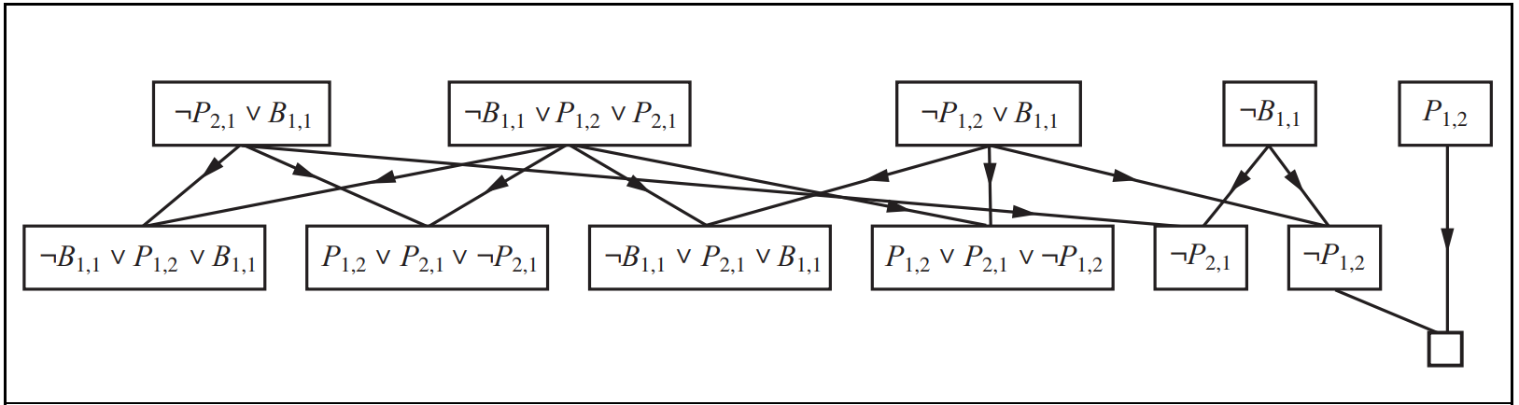
Wumpus World example
KB = R4 ∧ R5 = (B_{1,1} ⇔ (P_{1,2}∨ P_{2,1})) ∧¬ B_{1,1} α = ¬P_{1,2}

Slide 96
Efficient propositional inference
Two families of efficient algorithms for propositional inference:
Complete backtracking search algorithms
DPLL algorithm (Davis, Putnam, Logemann, Loveland)
Incomplete local search algorithms
WalkSAT algorithm

Slide 97
Limitation
Propositional logic has limited expressive power.
We cannot represent relations like ALL, some, or none with propositional logic. Example:
All the animals are intelligent.
Some apples are sweet.
We cannot describe statements in terms of their properties or logical relationships.

